Slide 1

Emotion Detection Through SPeech
Divvela vishnu sai kumar

Slide 2
Introduction
Emotion detection has become one of the biggest marketing strategies, based on mood of the consumer plays an important role. So to detect the current customer emotion of the person and suggest him the apt product or help him accordingly, will increase the demand of the product or the company.

Slide 3
introduction
Humans have the natural ability to use all their available senses for maximum awareness of the received message. The emotional detection is natural for humans but it is a very difficult task for machines.
Detecting emotions is one of the most important marketing strategy in the todays world.
For this reason, we decided to do a project where we could detect a persons emotions just by their voice which will let us manage many AI related applications.
Some examples could be including call centers to play music when one is angry on the call. Another could be a smart car slowing down when one is angry or fearful.

Slide 4

Basic analogy of project
Speech Signal
Deep Neural Network
Emotions

Slide 5
Dataset used
Ravdess: The Data set includes around 1500 audio file input from 24 different actors. 12 male and 12 female. Where these actors record short audios in Emotions.
1=Neutral, 2=calm, 3=happy, 4=sad, 5=angry, 6=fearful, 7=disgust, 8=surprised.
Each audio file is named in such a way that the 7th character is consistent with the different emotions that they represent.

Slide 6
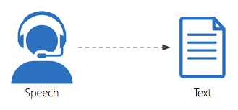
Speech to text translation using speech emotion recognition api:
Initially we tested the Audio by translating it back into the text mode using Speech emotion API to know what the audio is all about.

Slide 7
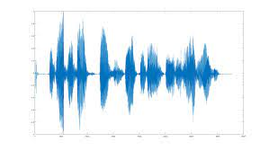
Analyzing audio signals:
Second Step is to test out the audio files by plotting out the waveform and spectrogram to see the sample audio files.

Slide 8
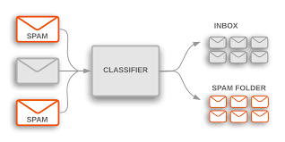
Building the model
Since the project is a classification problem, MultiLayer Perceptron seems the obvious choice. We choose this model to predict the right emotions.
The classifier connects to a Neural Network. Unlike other classification algorithms such as Support Vectors or Naïve Bayes Classifier, MLPClassfier relies on an underlying Neural Network to perform the task of classification.

Slide 9
Conclusions and challenges
The literature in speech emotion detection Is not very rich and researchers are still debating what features influence the recognition of emotion in speech. There is also considerable uncertainty as to the best algorithm for classifying emotion, and which emotions to class together.
In the real problem, different individuals reveal their emotions in a diverse degree and manner. There are also many differences between acted and spontaneous speech.

Slide 10
Drawbacks and future scope
You can try different other classifiers as well to predict the emotion behind the audio like CNN, SVM etc.
Predicting the Live audio takes a lot of process and its sometimes difficult to process as it is unlike the binary data with some csv files associated with it.
In Future, we can predict the random recorded audio as well.

Slide 11

Thank You
Divvela vishnu sai kumar

